Slide 1


Traffic Prediction
Naveen Reddy Garlapati
LQ63734
Prepared for : UMBC
Data Science Master Degree Capstone by: Dr Chaojie(Jay) Wang

Slide 2
Problem Statement
The goal of this project is to extract insights through data analysis and subsequently develop a model or models to forecast traffic at specific times at various city junctions.
Problem Statement
The model should provide predictions quickly.
Aim to reduce the Root Mean Squared Error (RMSE) and calculate the Mean Absolute Percentage Error (MAPE).
Verify if the model is overfitting by using stratified cross-validation.
Objectives

Slide 3




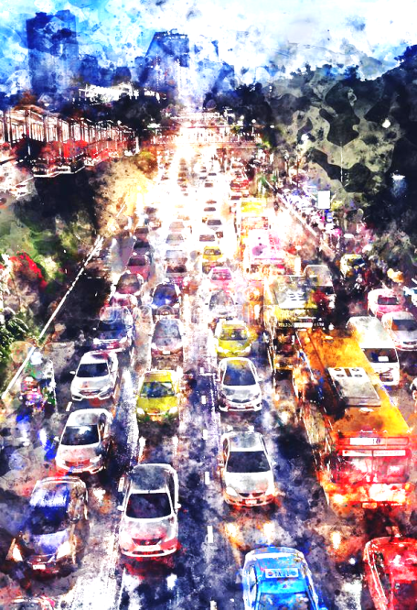


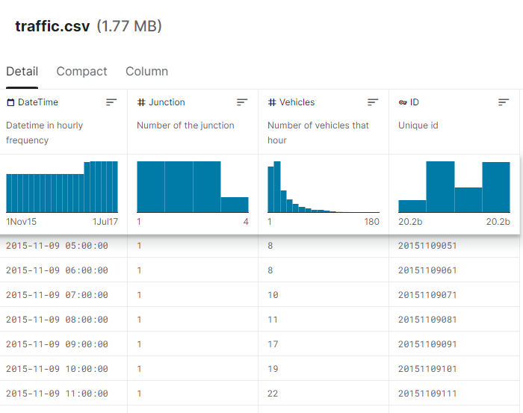


Dataset
Data
Data Collection
A CSV file with Number of Records: 48,120
Number of Features: 4
The data was collected from 2015 to 2017 at different times throughout the day.
Source of Data
Data Quality
https://www.kaggle.com/datasets/fedesoriano/traffic-prediction-dataset
Some junctions have supplied limited or sparse data, e.g., the 4th junction.

Slide 4



Model Evaluation and Optimization
Feature Extraction and Engg.
Step-1
Deriving additional characteristics from the DateTime Column.
Optimizing the hyperparameters of the selected LGBM model and evaluating feature significance to eliminate less relevant attributes.
Step- 4
Step-2
Step- 3
Feature Scaling and selection
Modelling
Constructing a Baseline Model employing top-performing algorithms (CatBoost, LGBM, RandomForest, and XGBoost), followed by overfitting assessment through stratified cross-validation (SCV) to determine the optimal model.
Utilizing Target Encoding to generate new attributes like {Junction, ID, Year, Month, Day_of_Month, Day_of_Week, Date, Time, Day_of_Year} incorporating aggregates such as Standard Deviation, Maximum, Minimum, Mean, and Median.
Reiterating to get best results

Slide 5
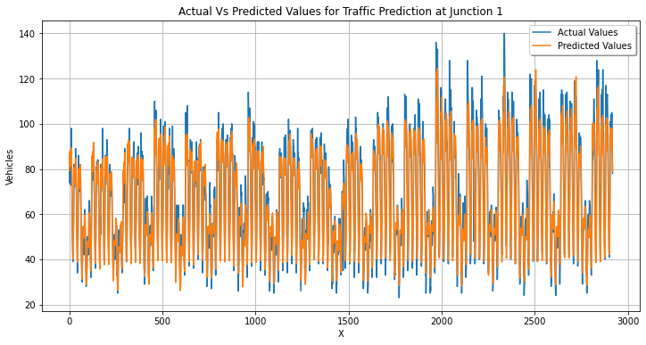
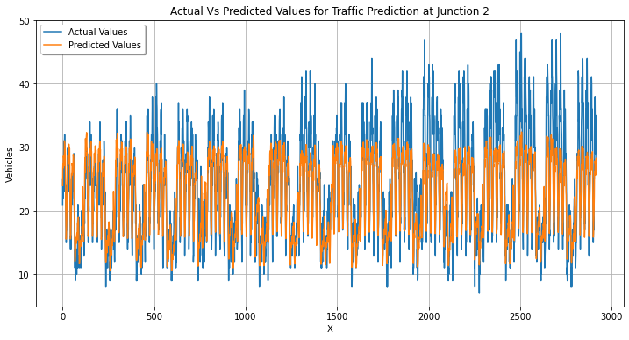
Modelling
Divided the Dataset into 4 parts for each junction and then tested various models to each subset to determine the optimal one .
The datasets were trained and tested on various models, including XGBoost, ARIMA, , Prophet, Ridge Regression, Lasso Regression, and LGBM.

Slide 6
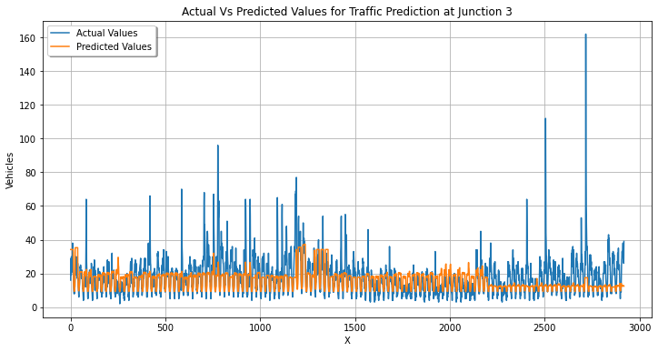
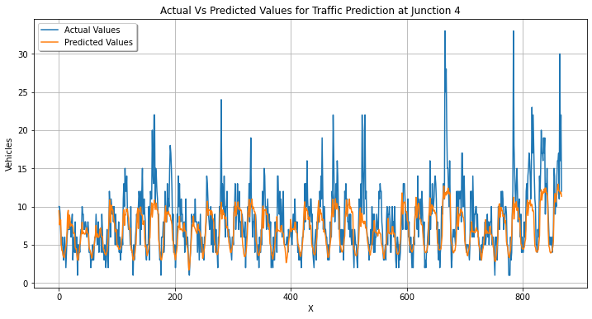

The performance of the LGBM model in comparing actual versus predicted outcomes is assessed based on RMSE and MAPE values. To boost performance, remodeling was carried out post feature selection.
Light GBM is prone to overfitting, particularly with small datasets, I employed cross-validation to mitigate this risk.
LGBM(Light Gradient Boosting Machine)

Slide 7
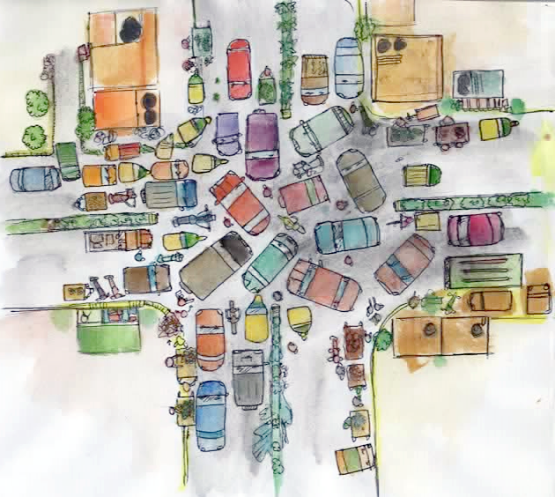
Deployment
Click!!

Slide 8
Thank you!

